Slide 1

NEW OC INCLUDED IN EFI CALENDAR
EQUESTRIAN SPORTS ACADEMY – GURGAON
RIDE TO LIVE ACADEMY – THANE
EQUINE GLOBAL CONSULTANTS (EGC) – DELHI
EXCELLENTIA EQUITATION CENTRE – DELHI
TSEA – HYDERABAD
HIGHFIELD EQUESTRIAN CENTRE – COONOOR, OOTY

Slide 2
DRESSAGE COACHING CAMP : 20 OCT - 05 NOV 2016
AT ARMY EQUESTRIAN CENTRE, DELHI
COACH MS JENNIE LORISTON-CLARKE MBE. FBHS (INTERNATIONAL LEVEL 3 TRAINER) AND REPRESENTED GREAT BRITAIN IN 4 OLYMPIC GAMES, MUNICH, MONTREAL, LOS ANGLES AND SEOUL IN THE DRESSAGE EVENTS AND WAS 6TH IN THE ALTERNATE OLYMPICS 1980
ATHLETES :-
COL RAJESH PATTU, SJRP, VSM MS MANISHA PATTU MS BEEYA VOHRA MS AVANI SHARMA MR BILAYAT KHAN MR DVENDRA SINGH RATHORE CAPT PRITAM MISHRA CAPT APURVA DABHADE DFR RAJENDER SINGH CAPT AMIT CHOUDHARY SWR PAWAN KUMAR SWR SUSHIL KUMAR SWR RAJ KUMAR SWR AVDESH KUMAR SWR P VISHWANATH | MS HIRAL JOSHI MS PARIDHI JOSHI MR ROCHAK SOBTI MR ARYAN KHERA MS SAMARAH KHATAU MALANEY MS SHYLA SINGH MS SASHA SINGH MS ANCHITA PURI MR ANGAD SINGH LEHAL MR SHIVEN NATH MR ADITYA AYUSH SINGH MR HARJIT BHALLA MR BALAJI VIJAYSHANKAR MAJ SUHEL NAGARKAR CAPT VAIBHAV LAKRA

Slide 3
SHOW JUMPING COACHING CAMP : 20 JAN- 05 FEB 2017
AT RVC CENTRE AND COLLEGE, MEERUT
COACH MR JOHN STEELS, UKCC LEVEL 3 HIGH PERFORMANCE SHOW JUMPING COACH
ATHLETES :-
LT COL AK GOSWAMI MAJ SALIM PATHAN MS SANYOGEETA KADU MAJ HARMANJEET SINGH LT COL VIVEK MISHRA MAJ JS NEGI LT ARTI RAWAT LT COL RAJ SANGRAM SINGH MR SANSRISHT BHATIA MR ASHISH VIVEK LIMAYE | LT COL VIKRAM NEHRA SPR SHALINDER SPR GURJOG MR GURSHOBHA SINGH MR VISHAL BARGIA BISHNOI MR AJAY JHALA MR ACHYUT KARANDE CAPT PRITAM MISHRA MS KAVITA SWITTENS MAJ ASHISH MALIK

Slide 4

COACHING OF COACHES (SHOW JUMPING)
WEF 21 TO 25 MAR 2016
COURSE DIRECTOR : MR NICK VERLIES (BELGIUM) (INTERNATIONAL SHOW JUMPING TRAINER)
COACHING OF COACHES (SHOW JUMPING): PARTICIPANTS
MAJ SUHEL NAGARKAR
LT COL S K DAHIYA
MR INDERJEET SINGH
COL DUSHYANT BALI
COL S S AHLAWAT, VSM
SUB/MAJ GIRDHARI LAL
MAJ SAMEER CHAUDHARY
RIS/MAJ SUNIL KUMAR
RIS RAJESH KUMAR
LT COL ABHIJIT KUMAR
LT COL VIVEK MISHRA
HONY/CAPT GULAB SINGH (RETD)
BRIG T S HASSANWALIA (RETD)
COL R S AHLUWALIA (RETD)
COMDT NARESH TEHLAN

Slide 5
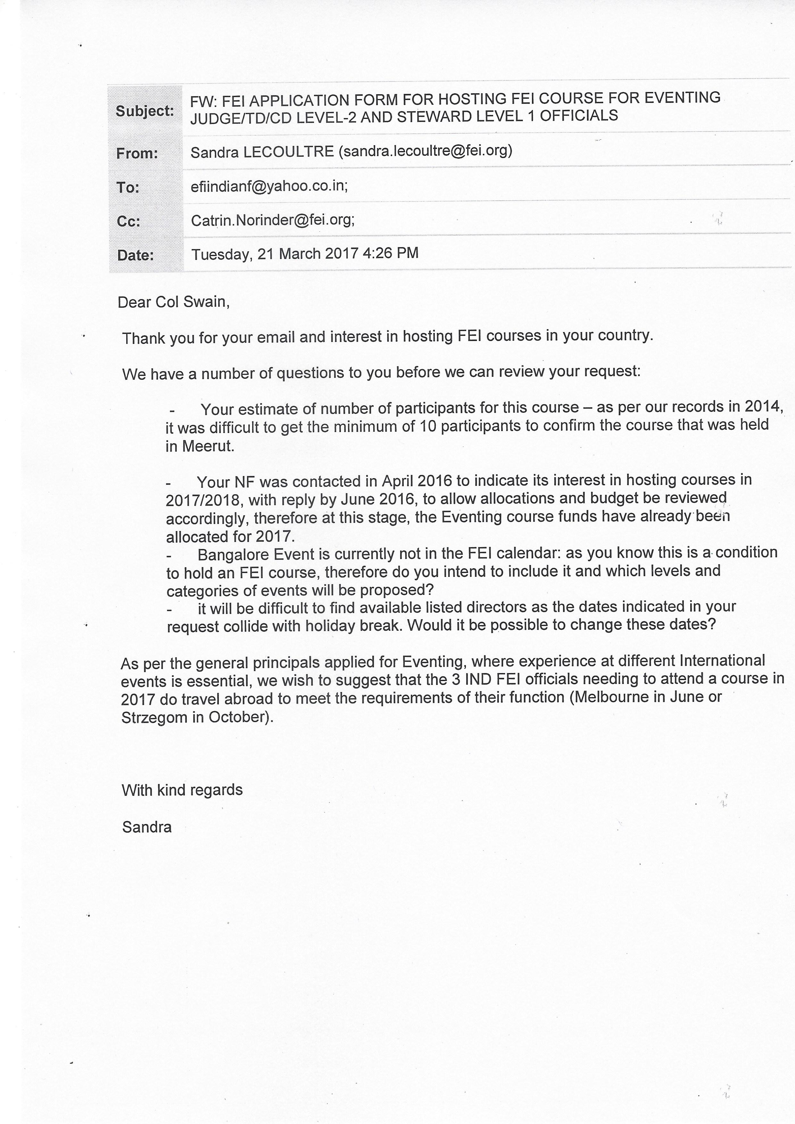

Slide 6
DRESSAGE CLINIC HELD AT APRC FROM
29 OCT TO 31 OCT 2015
COURSE DIRECTORS : MS NATALLIA RUBASHKO (FEI 3/4* JUDGE)
NO OF PARTICIPATNS
COL SUKHDEV RATHORE
COL RS AHLUWALIA (RETD)
LT COL HR SUNIL
COL RK SWAIN
LT COL ROHIT DAGAR
MR INDERJEET SINGH
LT COL DP NANDA

Slide 7
DRESSAGE CLINIC HELD AT APRC FROM
17-20 JAN 2016
COURSE DIRECTORS : COL FUANGVICH ANIRUTH DEVA (FEI 3* JUDGE)
NO OF PARTICIPATNS
MAJ AMIT SINSINWAR
LT COL D P NANDA
COMDT NARESH TEHLAN
COL S S JAMWAL
COL SANJAY MALIK
MR PRADEEP DHINGRA
MR ABHIJIT NANDY
MAJ ALOK K PALEI
LT COL ASHOK KUMAR
RIS MAHESH KUMAR
RIS RAJESH KUMAR
MR DHANANJAI G
LT COL VIKRAM NEHRA
MAJ SUHEL NAGARKAR
LT COL A K GOSWAMI
LT CDR MONALI BHAUMIK
ASST COMDT RAVESHWAR SINGH RANA
BRIG GS PURI

Slide 8
DRESSAGE CLINIC HELD AT APRC FROM
02 – 05 NOV 2016
COURSE DIRECTORS : MR PETER HELMUT ENGEL, FEI 4* JUDGE
NO OF PARTICIPATNS
MS BEEYA VOHRA
COL PP SINGH (RETD)
COL SS AHLAWAT, VSM
COL HR SUNIL
COL RS AHLUWALIA (RETD)
COL SS RATHORE
LT COL DP NANDA
LT COL CV CARTER ARULRAJ
MAJ SUHEL NAGARKAR
MS KAVITA SWITTENS
MR GAURAV PUNDIR
MS SANDRA SCHATZ KALAAN

Slide 9
NATIONAL EVENTING COURSE FOR NATIONAL JUDGES AND TDs LEVEL 1
COURSE DIRECTORS : ANNE-METTE BINDER, 3*/4* FEI JUDGE DENMARK DETAILED BY FEI) – OVERALL COURSE DIRECTOR
NO OF PARTICIPATNS
TECH DELEGATE
COMDT NARESH TEHLAN
MR INDERJEET SINGH
LT COL ALOK PALEI
JUDGE LEVEL 1
COL HR SUNIL
MR PALVINDER SINGH
MAJ SK DAHIYA
COL RS AHLUWALIA
COL RK SWAIN
COL JYOTI DHAWAN
OBSERVER JUDGE
LT COL DP NANDA
LT COL CV CARTER ARULRAJ
LT COL AK GOSWAMI

